Slide 1
Round Table
September 5-8

Slide 2
Tuesday
Weekend Share
Bus Pass Information
Today - you must have a bus pass to get onto the bus at the end of the day.
It is very important for students to see Mrs. Hogenson today to correct any errors.
*You did not receive a bus pass.
*You assigned the wrong pass.
*You need two buses on your pass.
When you can go see Mrs. Hogenson – during E&R
Keep your bus pass in a safe place. You may take a photo of it on your phone. If you lose your bus pass, you may see Mrs. Hogenson during E&R OR you may stop by her station on the ramp on your way out of the building.

Slide 3
Tuesday - Friday GRIT
“Grit is not just simple elbow-grease term for rugged persistence. It is an often invisible display of endurance that lets you stay in an uncomfortable place, work hard to improve upon a given interest and do it again and again.” Sarah Lewis
Write the quote in planner under “Things to Study” on the right.
Discuss and talk about examples in school or outside of school.

Slide 4
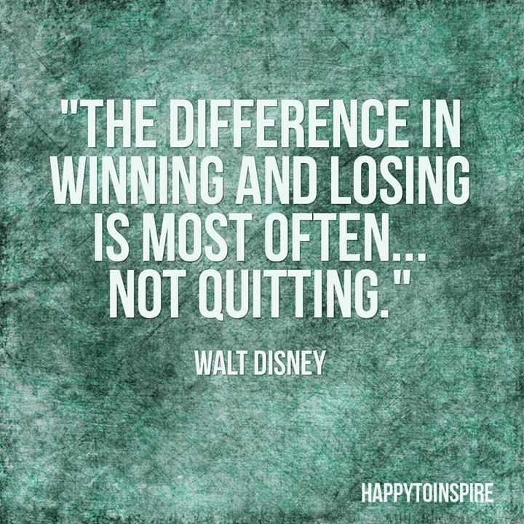
Write this quote in your planner under the other quote.
Discuss.

Slide 5
On Quitting BY EDGAR ALBERT GUEST
1 of 2 slides
How much grit do you think you’ve got?
Can you quit a thing that you like a lot?
You may talk of pluck; it’s an easy word,
And where’er you go it is often heard;
But can you tell to a jot or guess
Just how much courage you now possess?
You may stand to trouble and keep your grin,
But have you tackled self-discipline?
Have you ever issued commands to you
To quit the things that you like to do,
And then, when tempted and sorely swayed,
Those rigid orders have you obeyed?

Slide 6
Don’t boast of your grit till you’ve tried it out,
Nor prate to men of your courage stout,
For it’s easy enough to retain a grin
In the face of a fight there’s a chance to win,
But the sort of grit that is good to own
Is the stuff you need when you’re all alone.
How much grit do you think you’ve got?
Can you turn from joys that you like a lot?
Have you ever tested yourself to know
How far with yourself your will can go?
If you want to know if you have grit,
Just pick out a joy that you like, and quit.
It’s bully sport and it’s open fight;
It will keep you busy both day and night;
For the toughest kind of a game you’ll find
Is to make your body obey your mind.
And you never will know what is meant by grit
Unless there’s something you’ve tried to quit.

Slide 7
Songs
https://www.youtube.com/watch?v=NuTY-xEdf74
https://www.youtube.com/watch?v=TY41o-iZStI
https://www.youtube.com/watch?v=2H5uWRjFsGc
https://www.youtube.com/watch?v=nvlTJrNJ5lA

